Slide 1


Notes:
Briana
Welcome to women who code rva!
So excited to be here kicking off our first event of the women who code chapter

Slide 2

Joanna Bergeron
Chief Talent Officer

Slide 3







Our networks are led by 400+ volunteer leaders who help propel women in tech
Notes:
Briana
Wwcode is led by 400+ volunteers and We couldn't’t bring this network together without an awesome core team some of whom you will hear from tonight.
Please stand up or raise your hands!

Slide 4

OUR MISSION
Inspiring women to excel in technology careers.
Notes:
Briana
Women Who Code prepares this generation of women in tech to be tomorrow’s role models.

Slide 5

OUR VISION
A world where women are representative as technical executives, founders, VCs, board members and software engineers.
Notes:
Briana

Slide 6
CODE OF CONDUCT
Women Who Code (WWCode) is dedicated to providing an empowering experience for everyone who participates in or supports our community, regardless of gender, gender identity and expression, sexual orientation, ability, physical appearance, body size, race, ethnicity, age, religion, socioeconomic status, caste, or creed. Our events are intended to inspire women to excel in technology careers, and anyone who is there for this purpose is welcome. Because we value the safety and security of our members and strive to have an inclusive community, we do not tolerate harassment of members or event participants in any form. Our Code of Conduct applies to all events run by Women Who Code, Inc. If you would like to report an incident or contact our leadership team, please submit an incident report form.
Notes:
Briana
make everyone aware
code of conduct that applies to all events
Available online to read in its entirety
-empowering experience for everyone.
-inclusive, events are safe and supportive space for all participants
-not tolerate harassment from any members
michele what are we doing tonight?

Slide 7
Let’s learn about each other!
Notes:
Rachel

Slide 8

Tiffany France
UX Designer & Software Developer
Notes:
Worked at large companies like Google and Capital One, as well as non profits and universities.
Published two full length course on Front End Technologies with focus on data visualization techniques.
Loves being mom, raising chickens, watching Gilmore Girls and eating fancy ramen.
Life goal is to find time to write a great American novel.

Slide 9
Overview of Front End Development

Slide 10

Notes:
Delight and magic

Slide 11
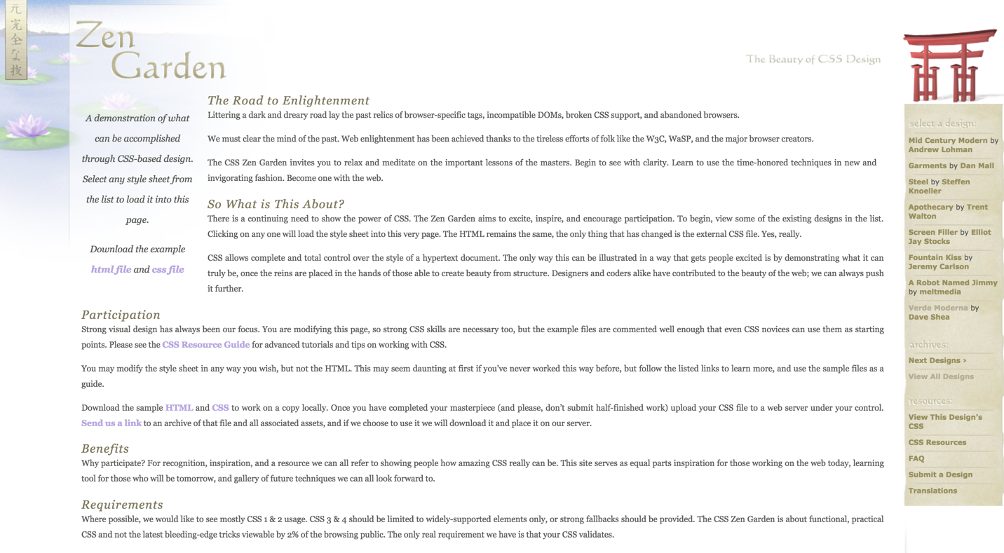
Notes:
CSS Zen Garden (May 2003) https://en.wikipedia.org/wiki/CSS_Zen_Garden “The goal of the site is to showcase what is possible with CSS-based design. Style sheets contributed by graphic designers from around the world are used to change the visual presentation of a single HTML file”

Slide 12


Slide 13


Slide 14


Slide 15


Slide 16

Notes:
CSS 3: (stages between 6/2011-6/2012): boxmodel, animations and transformations, font includes (leading to use of font icons like font awesome), media queries

Slide 17
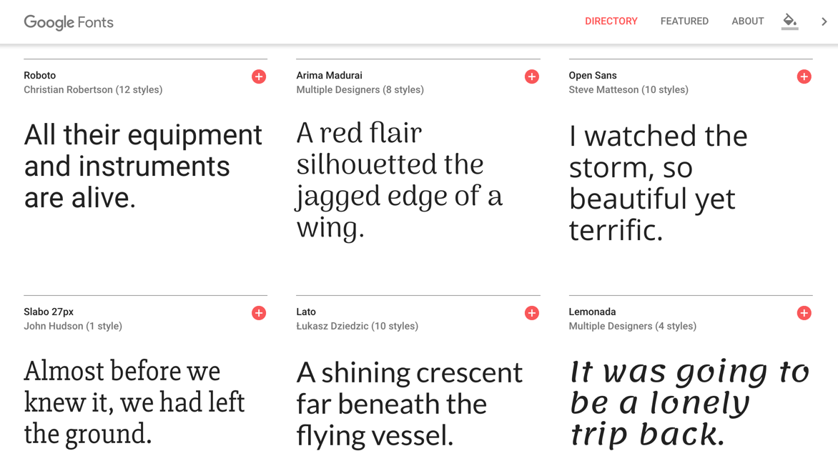

Slide 18

Notes:
http://femmebot.github.io/google-type/
Pheobe E.’s
AESOP’S FABLESwith
GOOGLE FONTS

Slide 19

Notes:
@mediaquery
Responsive Web Design
Progressive Web Apps

Slide 20
<script type="text/javascript">
// <![CDATA[
var colour="random"; // in addition to "random" can be set to any valid colour eg "#f0f" or "red"
var sparkles=50;
var x=ox=400;
var y=oy=300;
var swide=800;
var shigh=600;
var sleft=sdown=0;
var tiny=new Array();
var star=new Array();
var starv=new Array();
var starx=new Array();
var stary=new Array();
var tinyx=new Array();
var tinyy=new Array();
var tinyv=new Array();
window.onload=function() { if (document.getElementById) {
var i, rats, rlef, rdow;
for (var i=0; i<sparkles; i++) {
var rats=createDiv(3, 3);
rats.style.visibility="hidden";
rats.style.zIndex="999";
document.body.appendChild(tiny[i]=rats);
starv[i]=0;
tinyv[i]=0;
var rats=createDiv(5, 5);
rats.style.backgroundColor="transparent";
rats.style.visibility="hidden";
rats.style.zIndex="999";
var rlef=createDiv(1, 5);
var rdow=createDiv(5, 1);
rats.appendChild(rlef);
rats.appendChild(rdow);
rlef.style.top="2px";
rlef.style.left="0px";
rdow.style.top="0px";
rdow.style.left="2px";
document.body.appendChild(star[i]=rats);
}
set_width();
sparkle();
}}
function sparkle() {
var c;
if (Math.abs(x-ox)>1 || Math.abs(y-oy)>1) {
ox=x;
oy=y;
for (c=0; c<sparkles; c++) if (!starv[c]) {
star[c].style.left=(starx[c]=x)+"px";
star[c].style.top=(stary[c]=y+1)+"px";
star[c].style.clip="rect(0px, 5px, 5px, 0px)";
star[c].childNodes[0].style.backgroundColor=star[c].childNodes[1].style.backgroundColor=(colour=="random")?newColour():colour;
star[c].style.visibility="visible";
starv[c]=50;
break;
}
}
for (c=0; c<sparkles; c++) {
if (starv[c]) update_star(c);
if (tinyv[c]) update_tiny(c);
}
setTimeout("sparkle()", 40);
}
function update_star(i) {
if (--starv[i]==25) star[i].style.clip="rect(1px, 4px, 4px, 1px)";
if (starv[i]) {
stary[i]+=1+Math.random()*3;
starx[i]+=(i%5-2)/5;
if (stary[i]<shigh+sdown) {
star[i].style.top=stary[i]+"px";
star[i].style.left=starx[i]+"px";
}
else {
star[i].style.visibility="hidden";
starv[i]=0;
return;
}
}
else {
tinyv[i]=50;
tiny[i].style.top=(tinyy[i]=stary[i])+"px";
tiny[i].style.left=(tinyx[i]=starx[i])+"px";
tiny[i].style.width="2px";
tiny[i].style.height="2px";
tiny[i].style.backgroundColor=star[i].childNodes[0].style.backgroundColor;
star[i].style.visibility="hidden";
tiny[i].style.visibility="visible"
}
}
function update_tiny(i) {
if (--tinyv[i]==25) {
tiny[i].style.width="1px";
tiny[i].style.height="1px";
}
if (tinyv[i]) {
tinyy[i]+=1+Math.random()*3;
tinyx[i]+=(i%5-2)/5;
if (tinyy[i]<shigh+sdown) {
tiny[i].style.top=tinyy[i]+"px";
tiny[i].style.left=tinyx[i]+"px";
}
else {
tiny[i].style.visibility="hidden";
tinyv[i]=0;
return;
}
}
else tiny[i].style.visibility="hidden";
}
document.onmousemove=mouse;
function mouse(e) {
if (e) {
y=e.pageY;
x=e.pageX;
}
else {
set_scroll();
y=event.y+sdown;
x=event.x+sleft;
}
}
window.onscroll=set_scroll;
function set_scroll() {
if (typeof(self.pageYOffset)=='number') {
sdown=self.pageYOffset;
sleft=self.pageXOffset;
}
else if (document.body && (document.body.scrollTop || document.body.scrollLeft)) {
sdown=document.body.scrollTop;
sleft=document.body.scrollLeft;
}
else if (document.documentElement && (document.documentElement.scrollTop || document.documentElement.scrollLeft)) {
sleft=document.documentElement.scrollLeft;
sdown=document.documentElement.scrollTop;
}
else {
sdown=0;
sleft=0;
}
}
window.onresize=set_width;
function set_width() {
var sw_min=999999;
var sh_min=999999;
if (document.documentElement && document.documentElement.clientWidth) {
if (document.documentElement.clientWidth>0) sw_min=document.documentElement.clientWidth;
if (document.documentElement.clientHeight>0) sh_min=document.documentElement.clientHeight;
}
if (typeof(self.innerWidth)=='number' && self.innerWidth) {
if (self.innerWidth>0 && self.innerWidth<sw_min) sw_min=self.innerWidth;
if (self.innerHeight>0 && self.innerHeight<sh_min) sh_min=self.innerHeight;
}
if (document.body.clientWidth) {
if (document.body.clientWidth>0 && document.body.clientWidth<sw_min) sw_min=document.body.clientWidth;
if (document.body.clientHeight>0 && document.body.clientHeight<sh_min) sh_min=document.body.clientHeight;
}
if (sw_min==999999 || sh_min==999999) {
sw_min=800;
sh_min=600;
}
swide=sw_min;
shigh=sh_min;
}
Notes:
http://www.hotscripts.com/listing/fairy-dust/

Slide 21


Slide 22


Slide 23
Single Page Applications
Notes:
goal of providing a user experience similar to that of a desktop application
Replaces concept of “pages” with “states”

Slide 24

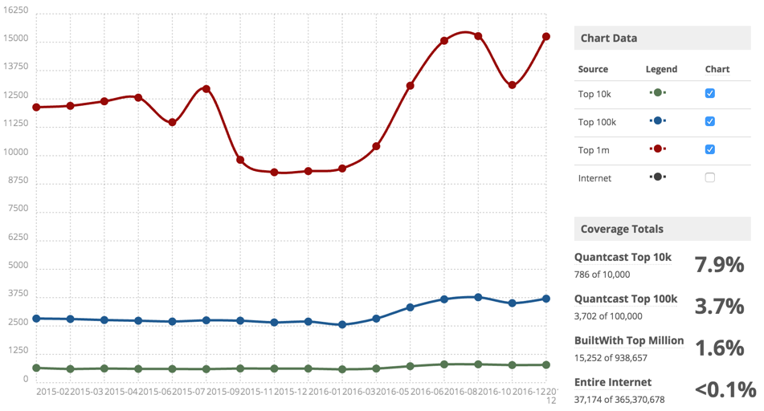
Notes:
Websites using backbone
786 of top 10,000 websites

Slide 25
Backbone Overview:
MVP, Routing - everything you need to build a SPA
Requires underscorejs, can be paired with jQuery
Simple structure for their small web applications
Developed by Jeremy Ashkenas author of CoffeeScript and Underscore
Backbone Downfalls:
Manual work
Notes:
Underscore provides utility functions for common programming tasks
Model–view–presenter

Slide 26

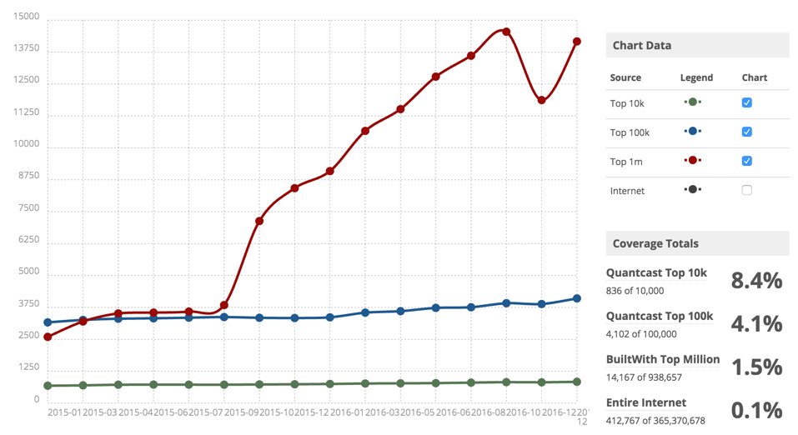
Notes:
October 20, 2010

Slide 27
Angular Overview
enterprise framework that many developers are using to build and maintain complex web applications.
two-way data binding between models and views.
Enables you to build reusable View Components.
Provides a services framework to allow easily backend-frontend server communication.
Angular Downfalls
Documentation
Performance
Notes:
When you are building a complex web front-end application and need a single modular framework to handle everything.

Slide 28

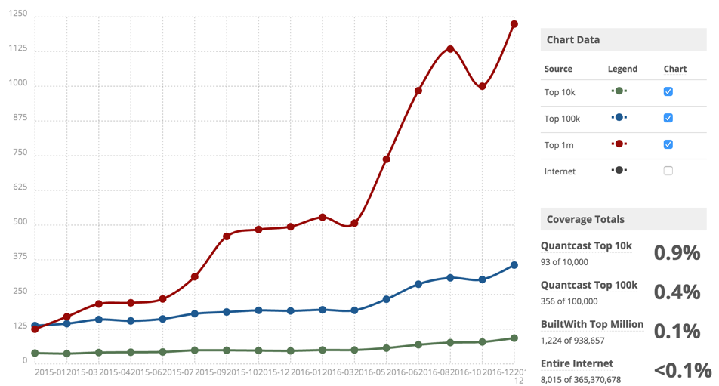
Notes:
1,224 of top 10,000 sites use react
https://trends.builtwith.com/javascript/React

Slide 29
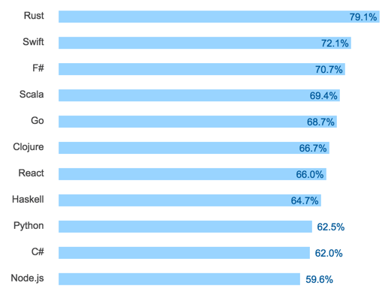
Notes:
Consistently ranked as one of the most loved frameworks
Graph from stack overflow survey from 2016
http://stackoverflow.com/research/developer-survey-2016#technology

Slide 30
Overview
Simpler library but it also does far less
the V in any MV* implementation
Flux or Redux
large, high load applications are already running on React
Facebook
Downfalls
React’s model mixes markup with JavaScript
Notes:
React is primarily concerned with how visual components are built and rendered, and doesn’t deal with the flow of data or the actual physical structure of the application.
When to use React? When you want a powerful View layer but don’t need an elaborate framework for the rest of your application or when you want a View layer to go with your Angular, Backbone, or Ember application. When you are trying to build an isomorphic web framework.

Slide 31
Other Front End Stuff to Learn
Nodejs
NPM
Grunt/Gulp
Preprocessors
Other Frameworks

Slide 32
THANKS FOR LISTENING, Y’ALL!

Slide 33
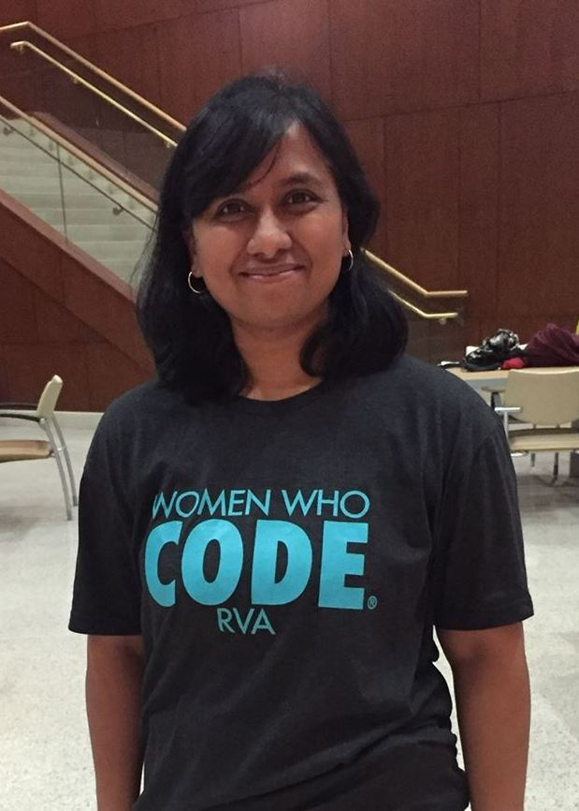
Shradha Kaldate
Sr. Front End Developer at Carmax
WWC-RVA Core Team Member

Slide 34

Fundamentals Of
https://angularjs.org
Notes:
Open Source, backed by Google, very popular

Slide 35
AngularJS
AngularJS is what HTML would have been, had it been built for web app.
Notes:
Elevator Pitch for Angular

Slide 36
Key Features of AngularJS
Two way data binding
MVC/MVVM Pattern
Declarative UI Template
Services
Dependency Injection
SPA Framework
Testable

Slide 37
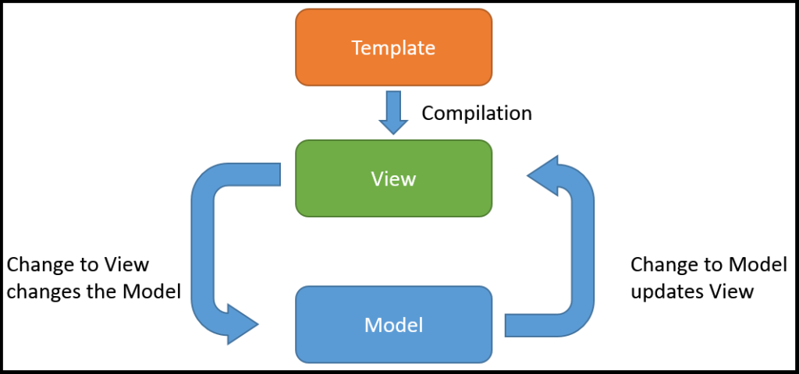
Two way data binding
Image: http://blog.thedigitalgroup.com/sheldonf/data-binding-with-angularjs/

Slide 38
Let’s start writing some code
https://github.com/skaldate/WWCRVA/tree/WWCRevision

Slide 39
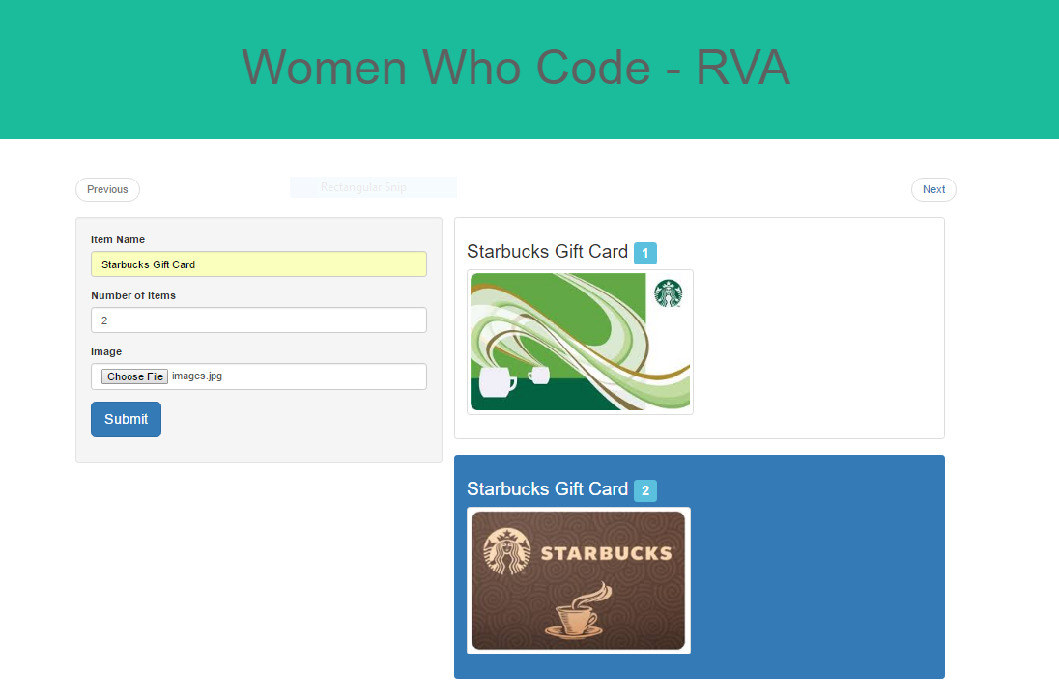

Slide 40
Design Patterns
Controller
ModelView
MVW
View
View
Model
Model
MVVM
MVC

Slide 41

Single Page Application
www.myApp.com/raffel
www.myApp.com/home
Initial Request
Subsequent Requests
HTML Page
JSON/ Partial Page

Slide 42
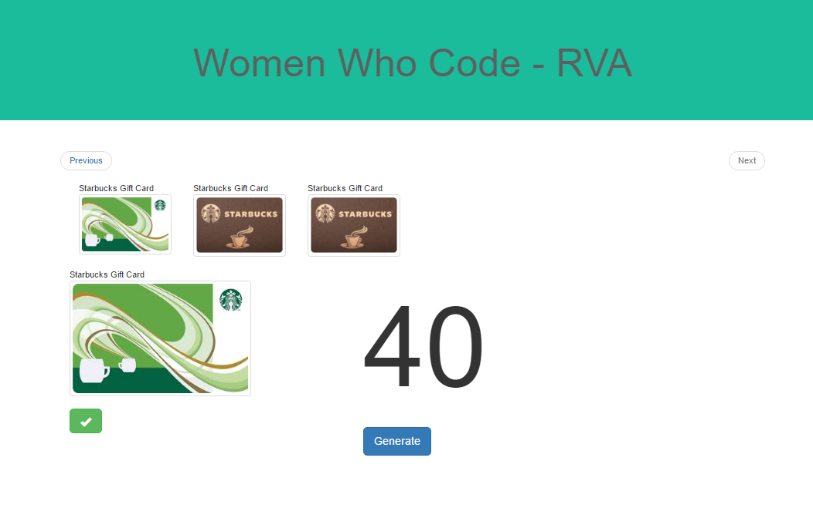

Slide 43
Service
Separation Of Concern
mainController
Singleton
itemsController
Lazy Loading
Services encapsulates shared behavior/reusable logic.
inventoryService
getInventory ()
updateItem()
someDirective
Reusable
CheckoutService
Application Level State

Slide 44

Dependency Injection
someService
app.controller(‘myController’, function($scope, ) {
var item =
}
someService.getItem();

Slide 45
Declarative UI Templates
Directives
Presentation
Behavior

Slide 46
Directives
Parent Scope
Directive Scope
@
$scope.var1
$scope.oneWayBind
=
$scope.var2
$scope.twoWayBind
$scope.func()
&
$scope.dirFunc()

Slide 47
https://github.com/skaldate/WWCRVA/tree/WWCRevision

Slide 48

Enu Mittal
Software Engineer at
Capital One
Notes:
Master’s Degree in Computer Applications
Capital One for 2 years
Java AngularJS NodeJS
Passionate about coding, cooking, travelling and socializing.
Expecting a baby!

Slide 49

Angular 2.0

Slide 50
Angular 2
Why Angular 2
Angular 2 Architecture
Angular 2 Best Practices
Migrating from Angular 1 to Angular 2
Angular 2 Learning Resources
References
Q & A
Notes:
Thank you Shradha. That was a great deep-dive into angularJS framework. While AngularJS (version1 s) are out in the technology world and millions of people are using it, Angular team released angular 2.x versions. Today, we will cover talk about.....

Slide 51
Why Angular 2
More productive and maintainable code
Enhanced performance and scalability
Simple to learn and adapt
Uses modern tools and technologies
New features
Notes:
Just now we were discussing and learning angular1. So, why angular 2?
Angular 2 improved on all the great features provided by ng1 and made it faster, more performant and scalable. Upto date with latest tools and technologies
With Angular 1, programmers had to understand the differences between Controllers, Services, Factories, Providers and other concepts that could be confusing, especially for new programmers.
Ng2 is written in ts, which follows ES6 standards (classes and structures) and not only UI developers, but also back end developers feel at ease when they see similar code and structures

Slide 52
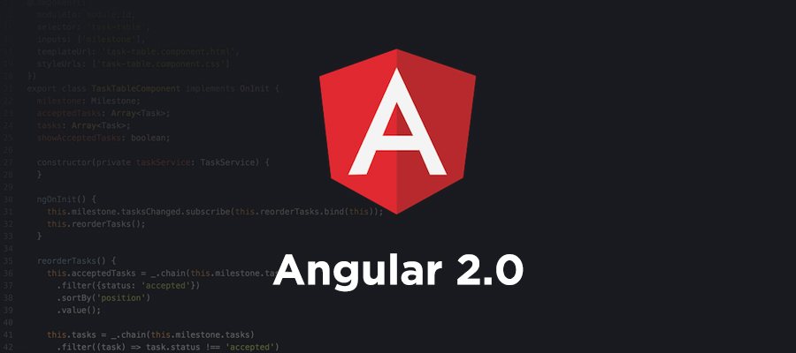




FAST
POWERFUL
CLEAN
EASY
Notes:
fast, powerful, clean and easy

Slide 53
Angular 2 Architecture
Language Choices
Transition: ng1 to ng2
Differences & Mapping

Slide 54
Language Choices
ES5
ES6
Typescript
Dart
No compile
Compile

Slide 55
Language Choices
ES5
ES6
Typescript
Dart
Javascript
No Javascript

Slide 56
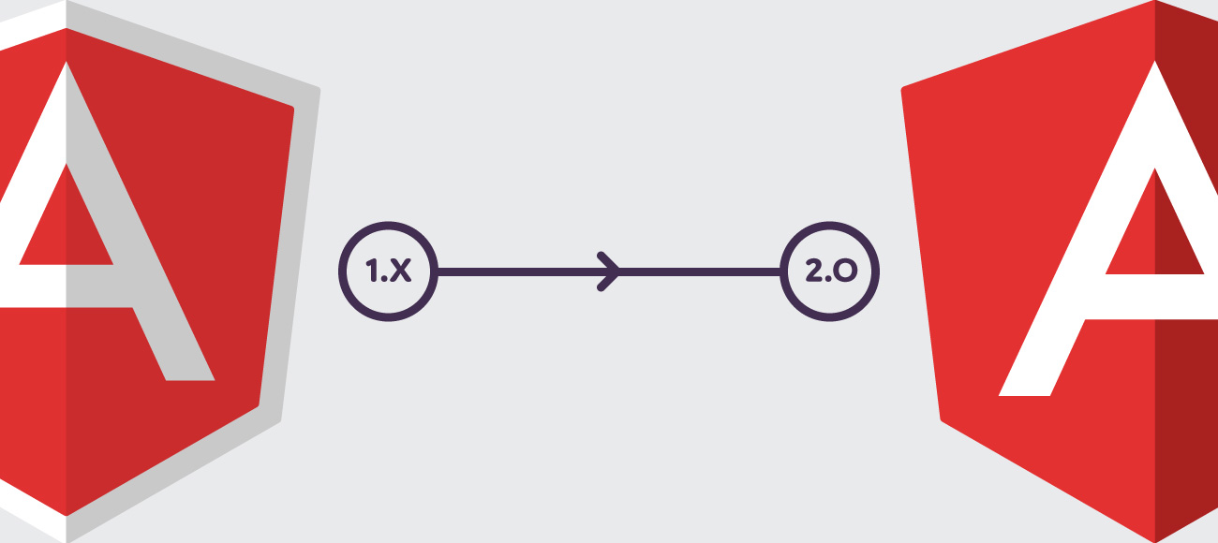
Transition from Angular1 to Angular 2
Angular Modules
Controllers to Components
Structural Directives
Data Binding
Angular 2 Directives
Services
Dependency Injection
7 Key Comparisons

Slide 57
Angular Modules
Angular 1
Angular 2
(function () {
angular
.module(‘app’, [ ] );
})();
<html ng-app=‘app’>
Import { NgModule } from ‘@angular/core’;
Import { BrowserModule } from ‘@angular/platform-browser;
@NgModule ({
imports: [BrowserModule],
declarations: [ … ],
bootstrap: [ ... ]
})
export class AppModule ()
Dependencies
Dependencies
Root Module
Root Module

Slide 58
Controller to Components
Angular 1
Angular 2
(function () {
angular
.module(‘app’, [ ] )})
.controller(‘UserController’, userController);
function userController(){
var user = this;
var info={‘id’:1, ‘name’:’Rob’};
} )();
<html ng-app=‘app’>
<body ng-controller=‘UserController as user>
<h2> {{user.info.name}} </h2>
</body>
</html>
Import { component } from ‘@angular/core’;
@component({
selector: ‘user-info’,
template: <h2>{{info.name}}</h2>
})
export class UserController {
info={‘id’:1, ‘name’:’Rob’};
};
<user-info></user-info>

Slide 59
Structural (built-in) Directives
Angular 1
Angular 2
<div ng-if=“condition”>
<ul>
<li ng-repeat=“detail in user.info”>
{{detail.name}}
</li>
</ul>
</div>
<div *ngIf=“condition”>
<ul>
<li *ngFor=let detail of info>
{{detail.name}}
</li>
</ul>
</div>
Notes:
Structural directive- prefixed with *
Changes the structure of the DOM

Slide 60
Data Binding
Interpolation
One Way Binding
Event Binding
DOM
COMPONENT
Two Way Binding
Notes:
Structural directive- prefixed with *
Changes the structure of the DOM

Slide 61
Interpolation
Angular 1
Angular 2
<h3> {{user.info.name}} </h3>
<h3>{{info.name}}</h3>
Notes:
{{user.info.name }} – ng1 we need context. Here, we have user….
Allows to put a default value in the DOM.

Slide 62
One Way Data Binding
Angular 1
Angular 2
<h3 ng-bind=“::user.info.name”> </h3>
OR
<h3 {{::user.info.name}}> </h3>
<h3 [innerText]=info.name></h3>
<div [style.color]=“color”>
{{info.name}} </div>
Notes:
{{user.info.name }} – ng1 we need context. Here, we have user….

Slide 63
Event Binding
Angular 1
Angular 2
<button
ng-click=“user.showAlert(‘hi’)”>
Click Me
</button
<button
(click)=“showAlert(‘hi’)”>
Click Me
</button>
Notes:
Ng-click, ng-blur
(click), (blur)

Slide 64
Two Way Data Binding
Angular 1
Angular 2
<input ng-model=“user.info.name”>
<input ng-bind=“user.info.name”>
<input [(ngModel)]=“info.name”>
Notes:
Ng-bind gives a default value, and until the DOM is ready, we see the default value

Slide 65
Services
Angular 1
Angular 2
Factories
Services
Class
Providers
Constants
Values
Notes:
Services- I should say all the building blocks of angular1 app.

Slide 66
Services
Angular 1
Angular 2
(function () {
angular
.module(‘app’, [ ] )})
.service(‘UserService’, userService);
function userService(){
this.getUserInfo = function() {
return [ {id:1, ’name’: ‘Rob’} ];
}
} )();
Import { Injectable } from ‘@angular/core’;
@Injectable
export class UserService {
getUserInfo = () => [
{id:1, ’name’: ‘Rob’}
];
}
Class

Slide 67
Dependency Injection
Angular 1
Angular 2
(function () {
angular.module(‘app’, [ ] )})
.controller(‘UserController’, userController);
userController.$inject = [‘UserService’];
function userController(UserService){
var user = this;
var info= UserService.getUserInfo();
} )();
Import { component } from ‘@angular/core’;
@component({
selector: ‘user-info’,
template: <h2>{{info.name}}</h2>
})
export class UserController {
info = this.userService.getUserInfo();
constructor(private userService: UserService) { }
};

Slide 68
Differences: Angular 1 vs Angular 2
Feature | Angular 1 | Transitional Phase | Angular 2
Nested Scopes ($scope) | Heavily Used | Avoided | GONE
Directives and controllers | Use as alternatives for a component | Directives as components | Component (directives rarely used)
Controller and service implementation | Functions | ES6 Classes | ES6 Classes
Module system | Angular's modules | ES6 Modules | ES6 Modules
Transpiler required | No | Typescript | Typescript

Slide 69
Mapping: Angular 1 to Angular 2
Controllers
Components
Component Directives
Services
Services
Decorator Directives
Directives
Filters
Pipes

Slide 70
Angular 2 Best Practices
Single responsibility
Naming and coding conventions
App structure and ng modules
Components, directives and services
Data sciences
Testing – unit and e2e
Notes:
Apply the Single Responsibility Principle to all components, services, and other symbols. This helps make the app cleaner, easier to read and maintain, and more testable.
Consistent naming patterns, Separate File Names with Dots and Dashes, app.componemt.ts, user.service.ts
All feature areas are in their own folder, with their own Angular module. Be descriptive about the names of files and folders. Avoid files with multiple components, multiple services, or a mixture. Do keep a flat folder structure as long as possible.
Do use dashed-case or kebab-case for naming the element selectors of components.
Member Sequence- Do place properties up top followed by methods., Do place private members after public members, alphabetized. Put Logic in Services. Do put presentation logic in the component class, and not in the template. Do use attribute directives when you have presentation logic without a template, because Attributes directives don't have an associated template.
writeUnit and e2e tests to explore and confirm the behavior of the application. They guard against changes that break existing code (“regressions”). They clarify what the code does both when used as intended and when faced with deviant conditions. They reveal mistakes in design and implementation.

Slide 71
Migrating from Angular 1.x to 2.0
Application
Rewrite
Maintain
Migrate
Notes:
Biggest Question: Why should I migrate to ng2. my app works great in ng1. I can quickly add features and develop in the existing code base.
Ng2 is significantly faster (1 can get messy and complicated if all best practices are not followed)
Simpler- have less concepts and differentiators to learn
Forward looking-built on modern tools n technologies and web standards
Additional Features- Lazy loading, server side rendering, multiple rendering targets beyond web- like mobile etc
3 choices to migrate: rewrite, maintain, migrate.
Ng2 is complicated if you try to migrate / upgrade from ng1 for massive apps.

Slide 72
Migration Plan
Follow style guide
Upgrade code to angular 1.5 or later
Write new code with components
Switch directives to components
Remove incompatible features/code
Implement bootstrapping
Add ES6 classes, typescript and a build

Slide 73
Angular 2 Learning Resources
Pluralsight
angular.io
egghead.io
https://github.com/jmcunningham/AngularJS2-Learning
Sites built with ng2: http://angularexpo.com

Slide 74
References
Angular 2: First Look – Presentation by John Papa
Angular Best Practices- Presentation by Joe Eames
Preparing for and Migrating Applications to Angular 2 - Presentation by Joe Eames
https://angular.io/

Slide 75


Introduction to communities
Deep Dive!
AngularJS Best Practices
Pitfalls to avoid performance issues
Code Raffel application using Angular2.
Code Raffel application using ReactJS.
NodeJS

Slide 76
Introduction to communities

Slide 77
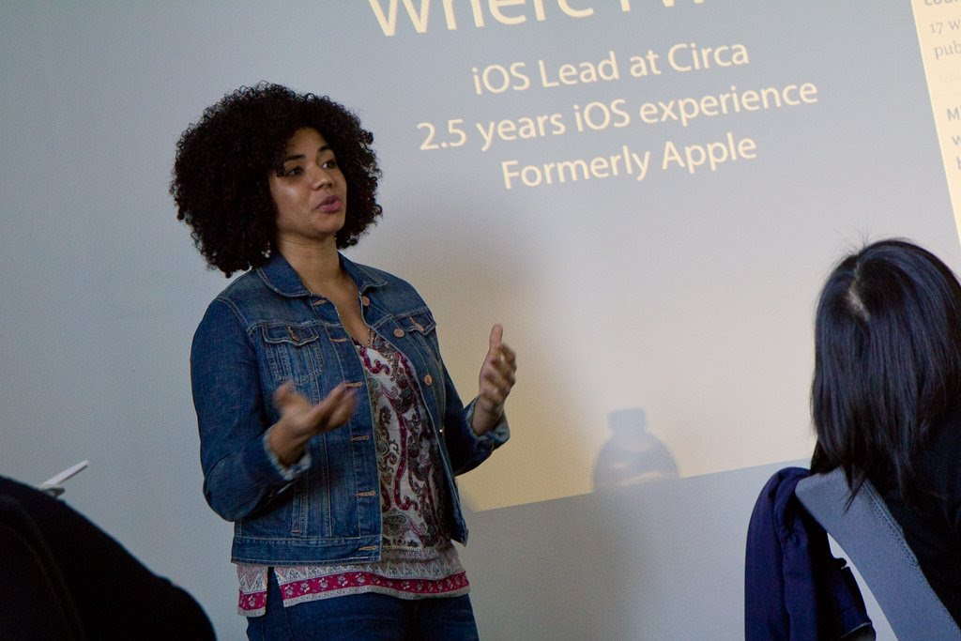
#ApplaudHer
#WWCodeRVA
Notes:
Michele introduce tweetwall

Slide 78
Stay Connected
meetup.com/women-who-code-richmond
@wwcoderichmond
https://wwcrva-slack.herokuapp.com/
Facebook!
Notes:
Briana

Slide 79

Feedback
https://goo.gl/forms/sEFozkcYPwudsQVj1

Slide 80
Get Involved
Participate, participate, participate
Lead (or help lead) an event
– training, study groups, workshop, code circle
Host an event
– provide space, food and Wifi
Notes:
Briana
Dont have to wait for the monthly meetup to create a community . **REITTERATE THIS**

Slide 81

THANK YOU!

